Slide 1
Data Analysis on
Maryland’s Statewide Vehicle Crashes
Group C: Dibya Pandey Adhikari, Jael Kruthi Battana, Pragathi Gopishetty
DATA 690: Special topics in Data Science (Stats and visualization)
Professor: Ergun Kacar
December 5, 2022

Slide 2
Introduction:
Dataset is taken from the open data portal of the state of Maryland.
Our dataset has information about statewide vehicle crashes from January 2015 through September 2022.
Related data that is taken for our data analysis includes information about the person and the vehicle that was involved in the crash.

Slide 3
About Datasets:
Maryland Statewide Vehicle Crashes | Maryland Statewide Vehicle Crashes Person Details | Maryland Statewide Vehicle Crashes Vehicle Details
Crash location and type, damage, vehicle, and after-action information. Rows: 715561 Columns: 56 | Driver description, pedestrian, injury, license type, and other information regarding the people involved in recorded crashes. Rows: 1664889 Columns: 32 | Information about the vehicles involved in recorded crashes, like vehicle type, its movement prior to and after the crash, the damage each involved party sustained. Rows: 1162313 Columns: 22

Slide 4
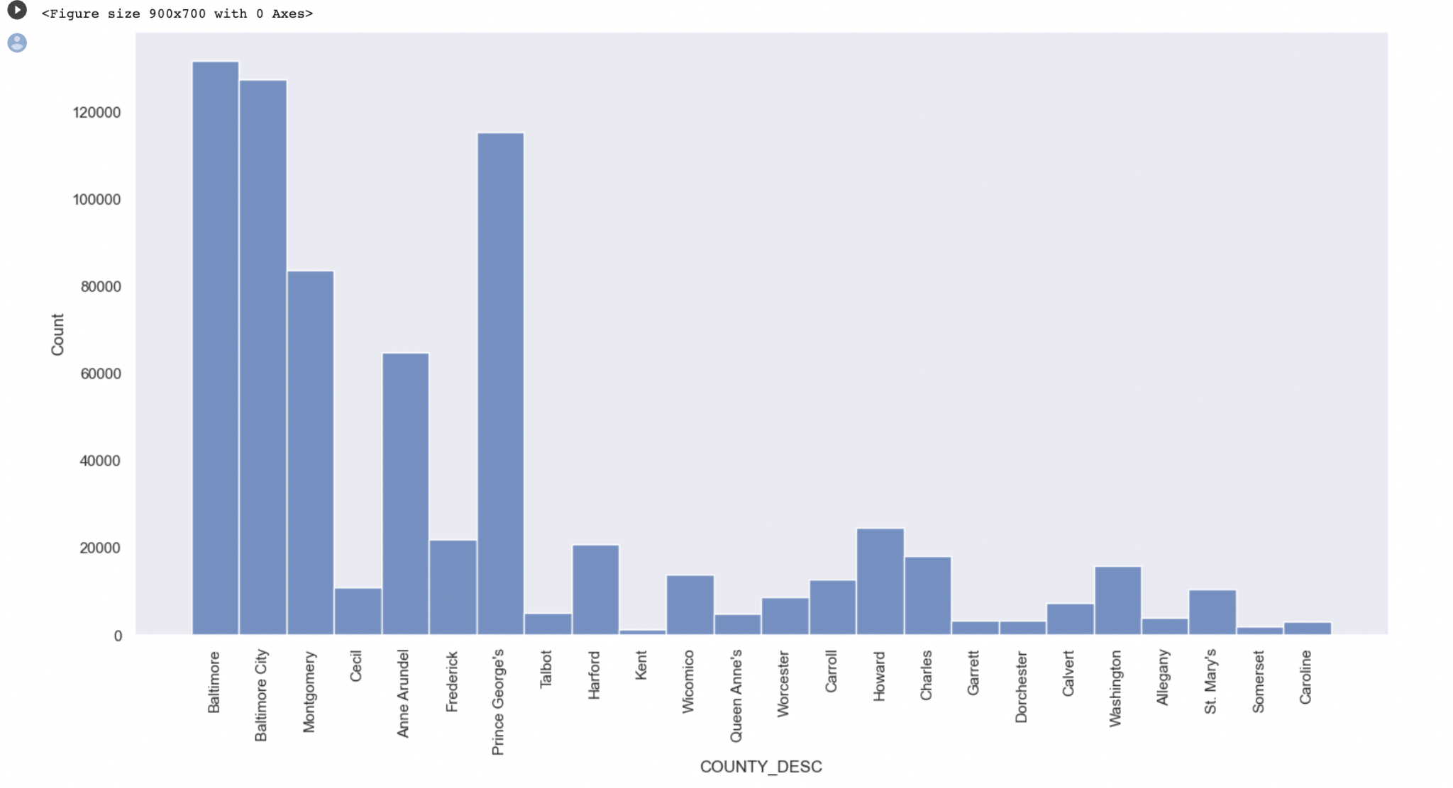
Exploratory Data Analysis
County with maximum number of crashes is Baltimore and crashes greater than 120000
Notes:
displot

Slide 5
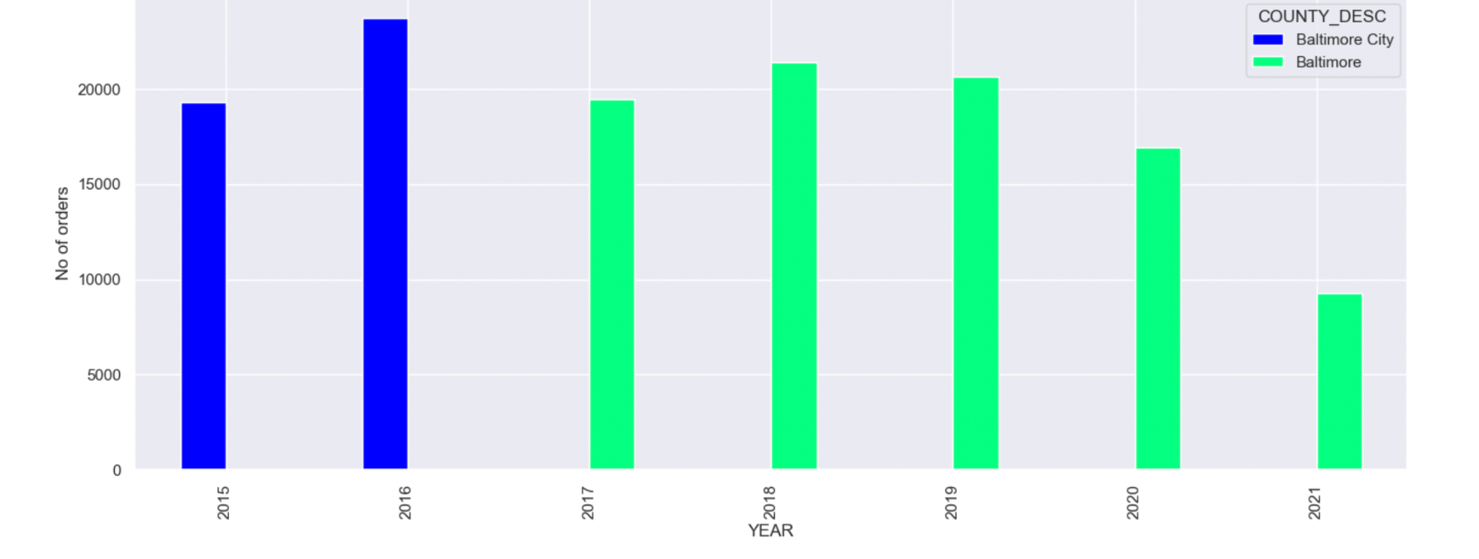
Exploratory Data Analysis
Highest number of accidents recorded in different years among different county
In Baltimore city county its year 2016 with more than 20000 accidents
In Baltimore county its year year 2018 with a little over than 20000

Slide 6
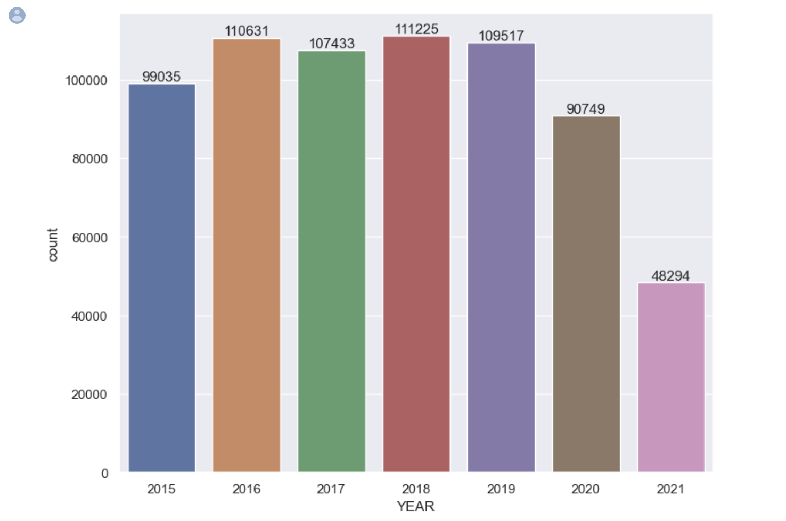
Exploratory Data Analysis
Variation in number of crashes recorded over the years
Year 2018 has highest number of crashes recorded whereas it reduced drastically in 2020 and 2021 due to travel restrictions and lockdowns during the pandemic.
Notes:
countplot

Slide 7
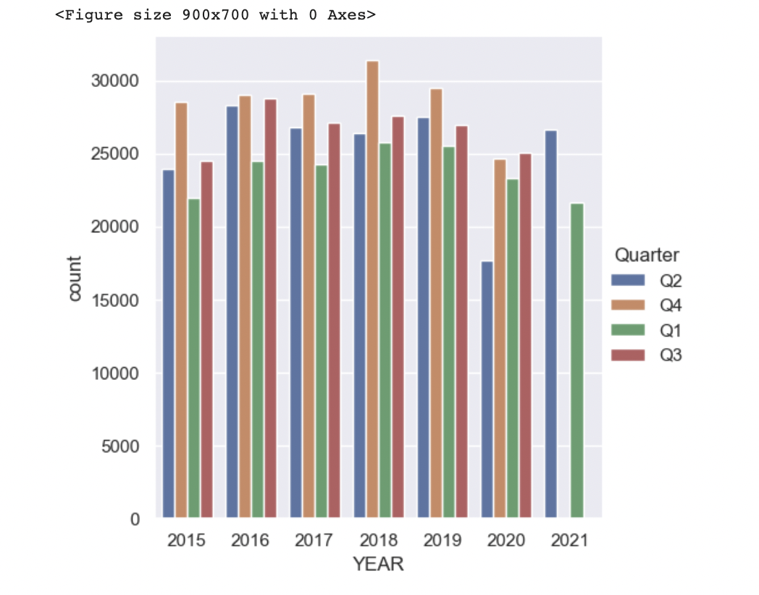
Exploratory Data Analysis
Variation in quarterly data of occurrence of crashes each year. Most accidents occurred in the fourth quarter of the year until 2020 and there are no accidents in 2021 in respective quarter.
Notes:
Catplot - categorises

Slide 8
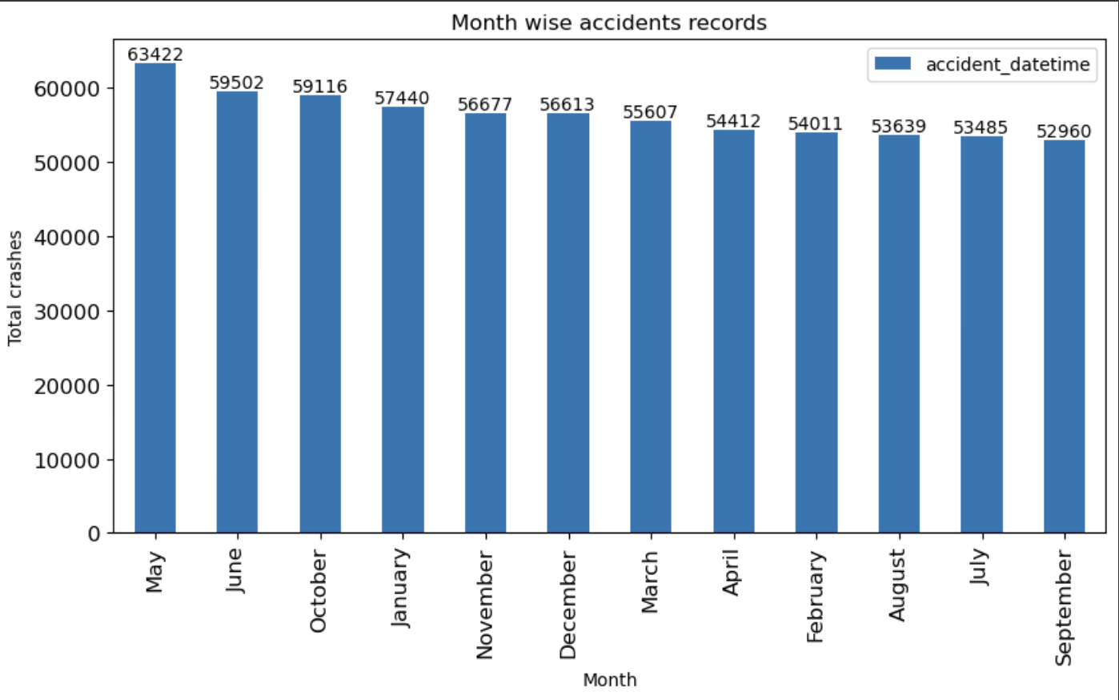
Exploratory Data Analysis
Crashes recorded on different months of the year. Highest number of crashes have been recorded in the month of May with 63422 number of crashes.
Notes:
The curve gradually falls after the spring and in summer the count of accidents is less. We can analyse that in after spring, more accidents took place due to the rain, ice and fog

Slide 9
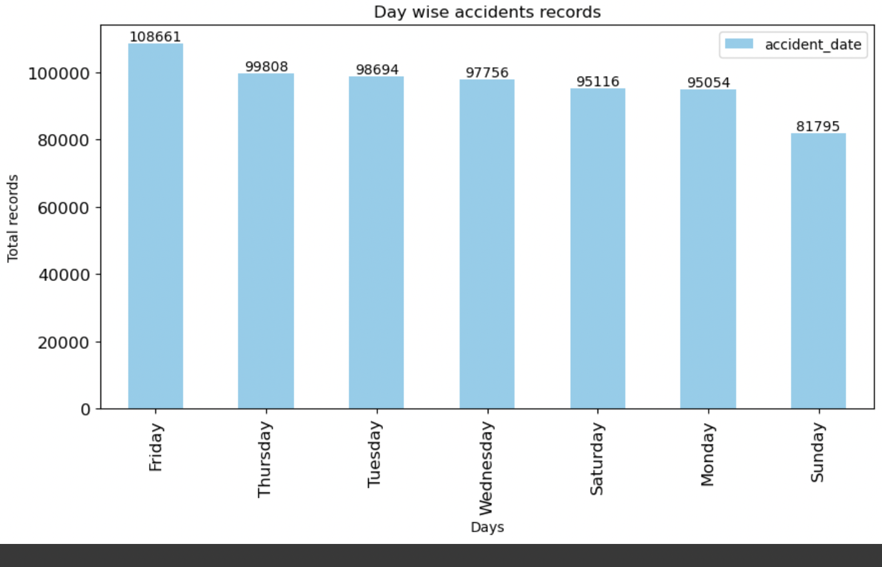
Exploratory Data Analysis
Highest number of accidents occurred on the day of the week is Friday with more than 100000 crashes.
Notes:
From above figure we can analyse the count is more during Thursday's and Friday's.
We can notice during the working days there is huge traffic and chances of having crashes are also high

Slide 10
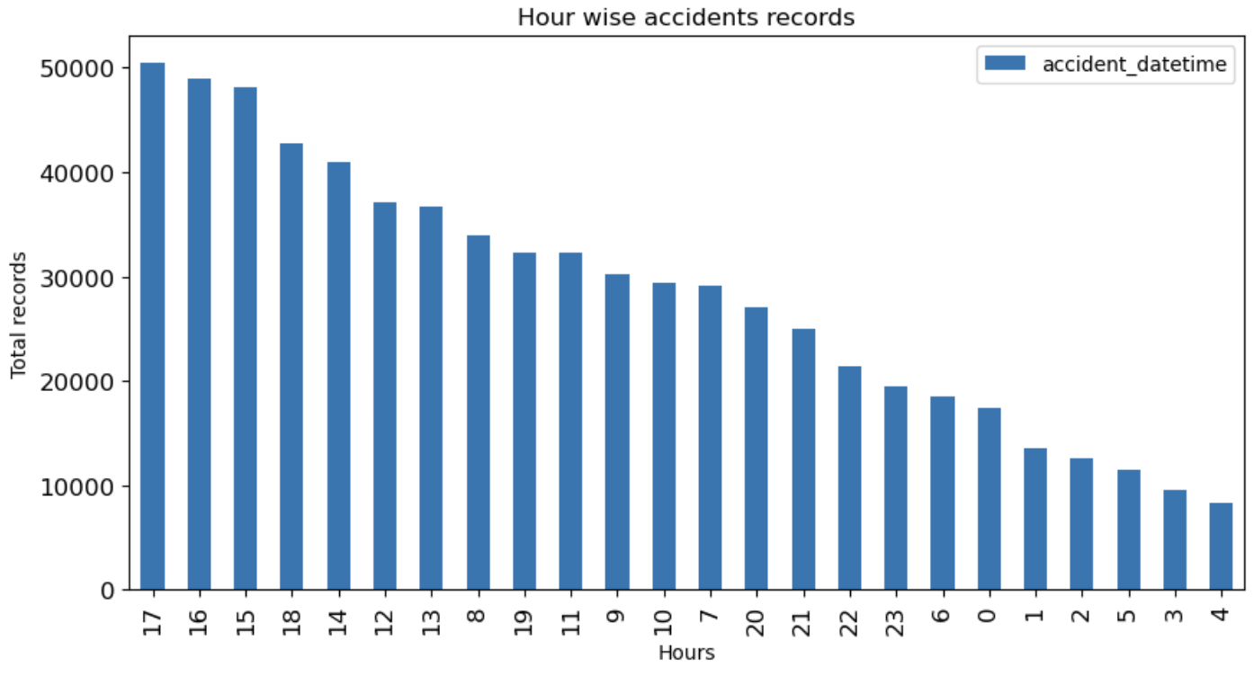
Exploratory Data Analysis
Highest number of accidents occurred at which hour in the day which is at the 17th hour approximately around 5 pm in the evening
Notes:
The above visualization we can notice that, the more number of accidents happens in between the hours from 15 to 20.
We can analyse that the count of accidents is more at night due to the less visibility the distance is hard to judge at night times.

Slide 11
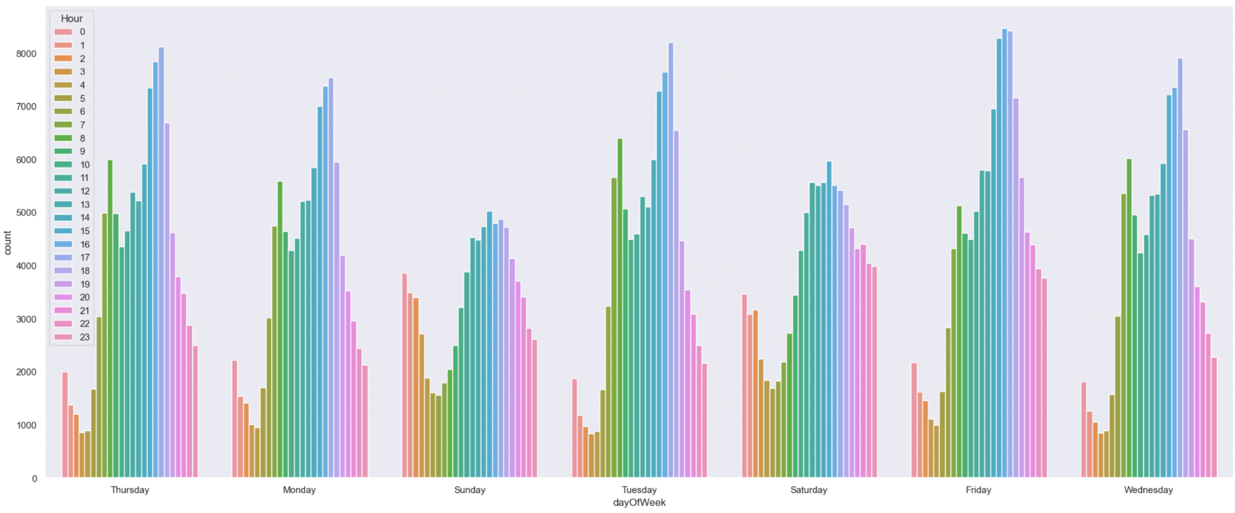
Exploratory Data Analysis
Analysis of crashes at any given hour of the day on every day of the week
Notes:
From above plot we can see there are more accidents on 3-9 pm and in the morning in between 6-10 am.
We can conclude it may be due to high traffic on office hours. Sundays and saturday have the least accidents as in weekend there is low traffic

Slide 12
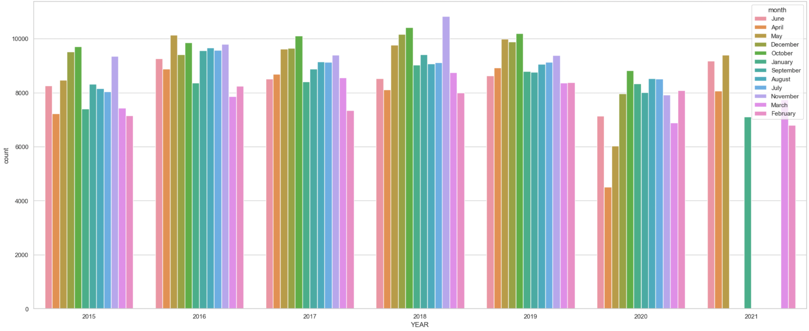
Exploratory Data Analysis
Analysis of crashes every month of an year
Notes:
Most accidents were recorded on first five month of year this may be due to ice,fog and cold

Slide 13
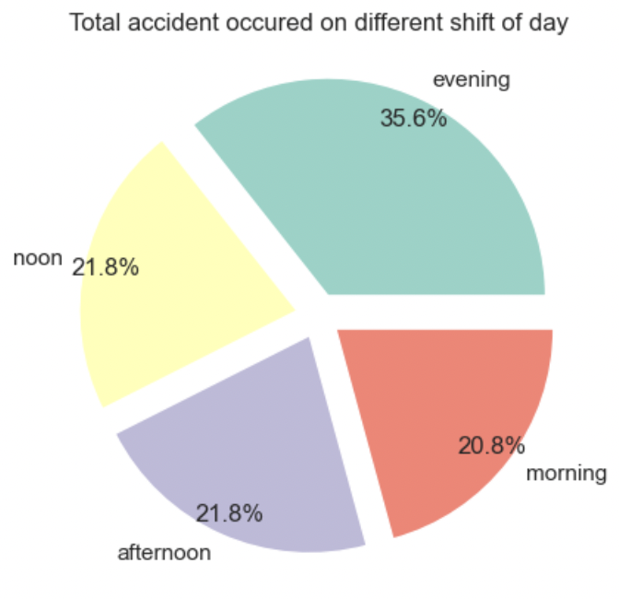
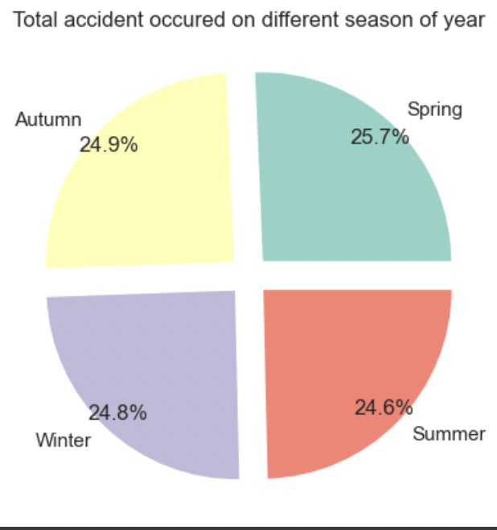
Exploratory Data Analysis
Most number of crashes have occurred in the evening especially in the spring season.
Notes:
This is the time most people are returning home or going out and its getting darker which blocks vision and in spring as its warm, most people tend to go outside.

Slide 14
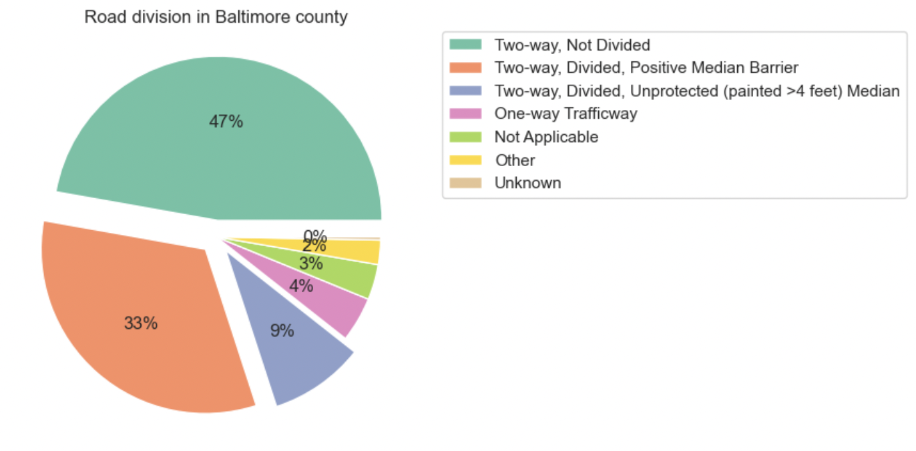
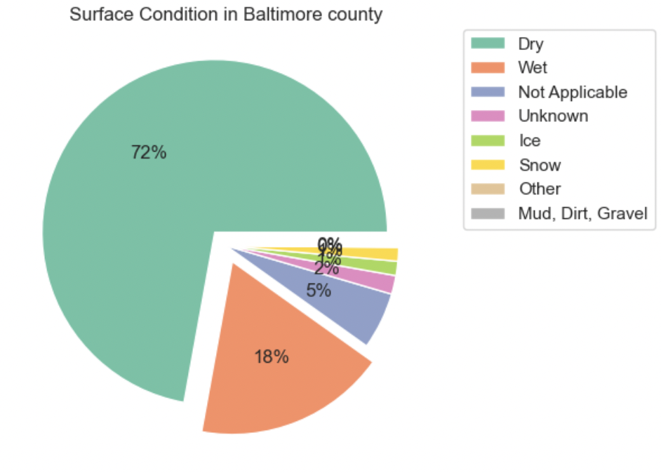
We have analysed that Baltimore county has the highest number of crashes among all the county’s.
Analysis on why there are more crashes based on road condition, surface and divider descriptions.
Notes:
This is the time most people are returning home or going out and its getting darker which blocks vision and in spring as its warm, most people tend to go outside.

Slide 15
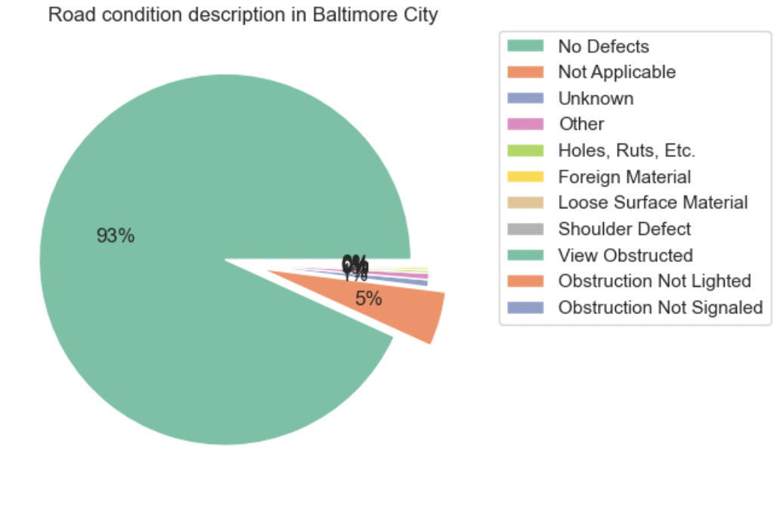
From plottings we can say that in Baltimore county many crashes have occured due to view of roads being obstructed and also due to the two sided road not being divided in between. People did not necessarily know which way to take and took the wrong division.
Notes:
This is the time most people are returning home or going out and its getting darker which blocks vision and in spring as its warm, most people tend to go outside.

Slide 16
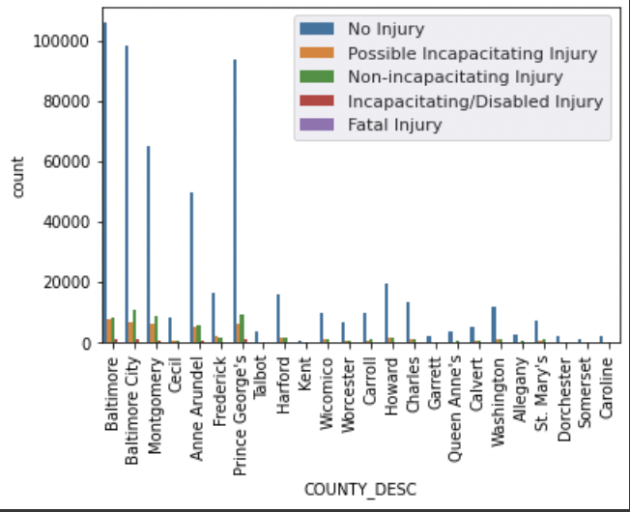
Analysis on injuries caused by crashes in each county.
Most of crashes had no injuries associated to them in every county.
Notes:
This is the time most people are returning home or going out and its getting darker which blocks vision and in spring as its warm, most people tend to go outside.

Slide 17
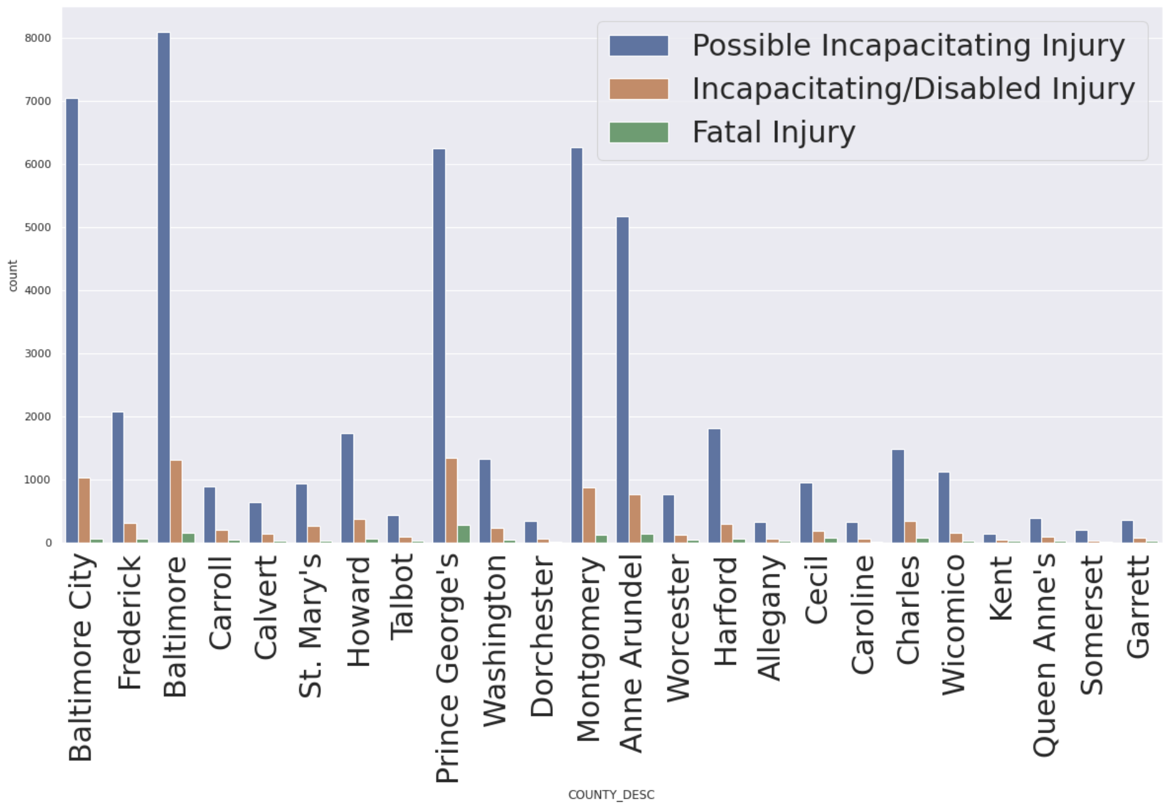
Analysis on injuries caused by crashes in each county.
Most of crashes had no injuries associated to them in every county.
Other than no injury, we can see that most crashes had possible incapacitating injuries in every county.
Notes:
This is the time most people are returning home or going out and its getting darker which blocks vision and in spring as its warm, most people tend to go outside.

Slide 18
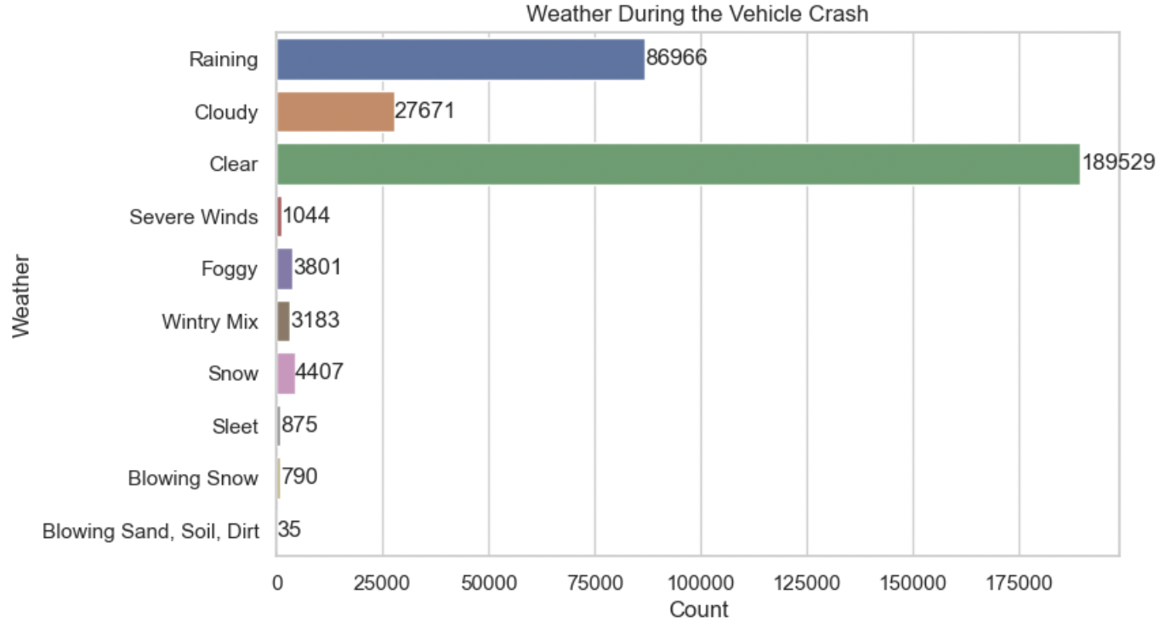
Analysis of the weather conditions during a vehicle crash.
Notes:
In rainy days the count is more due to the roads are wet and there are high chances to get skid

Slide 19
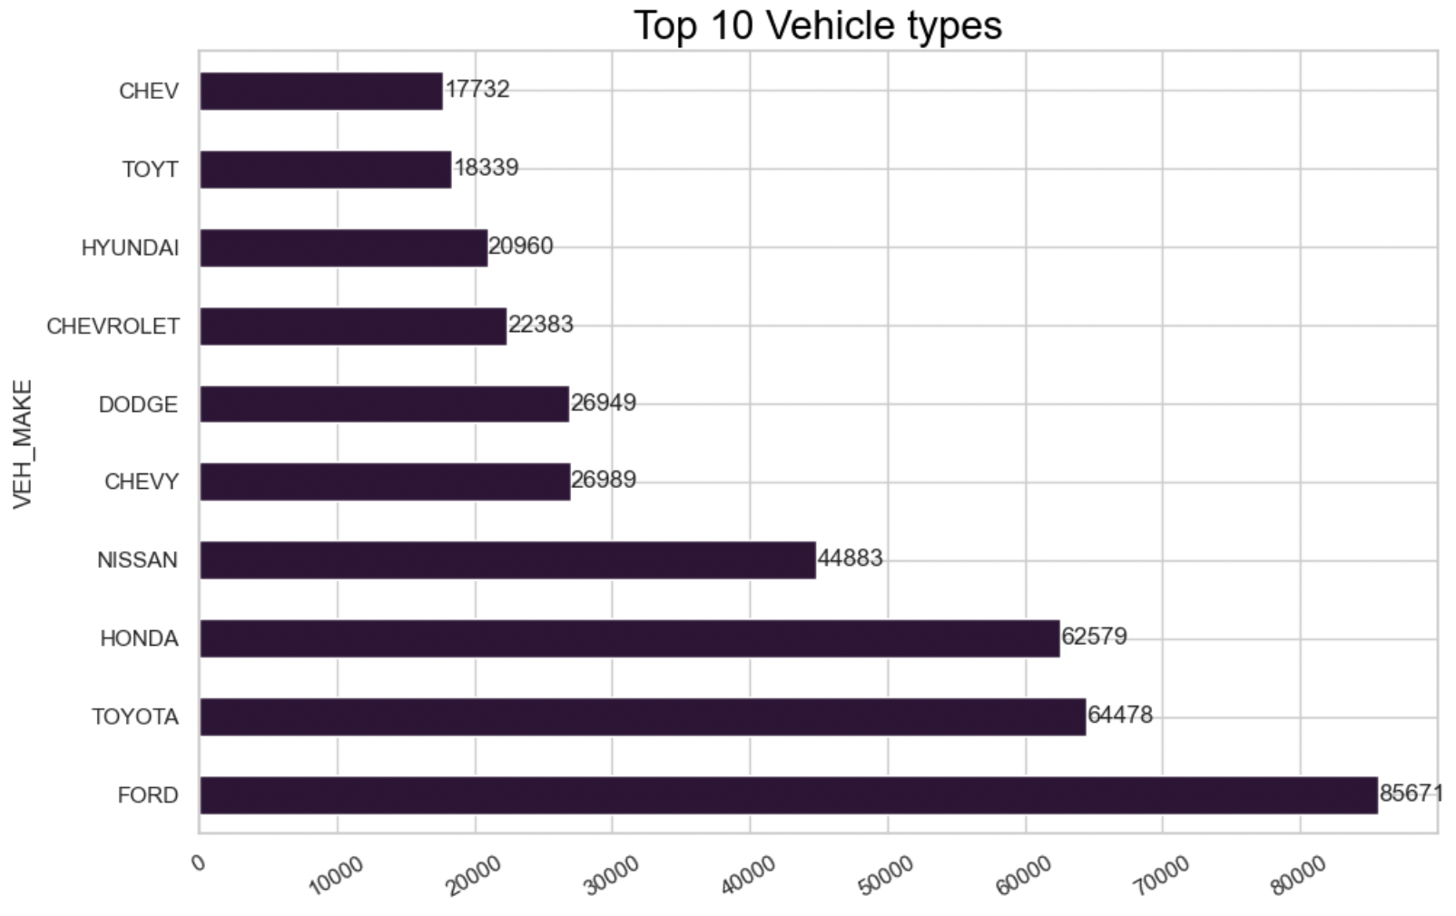
Analysis of the type of vehicle involved most crashes.
Notes:
Ford is the type of vehicle most of the crashes happened

Slide 20
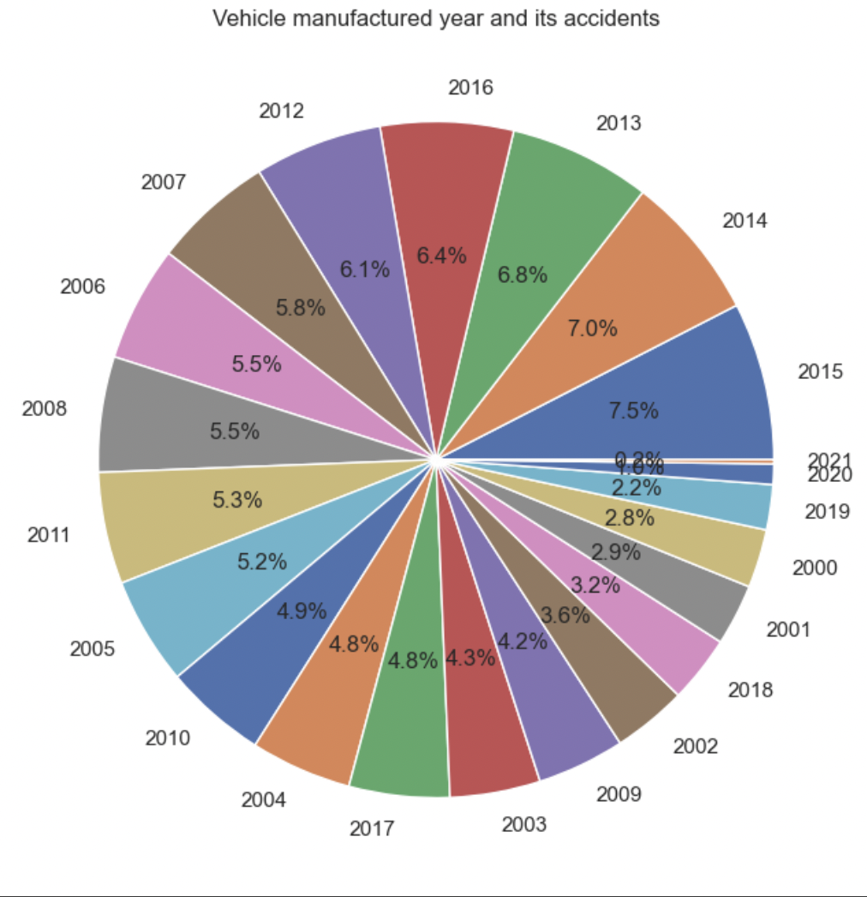
Analysis of the vehicle manufacture year involved in accidents.
From graph we can conclude vehicle manufactured in year 2015 has more crashes and 2021 have the least
Notes:
\\

Slide 21
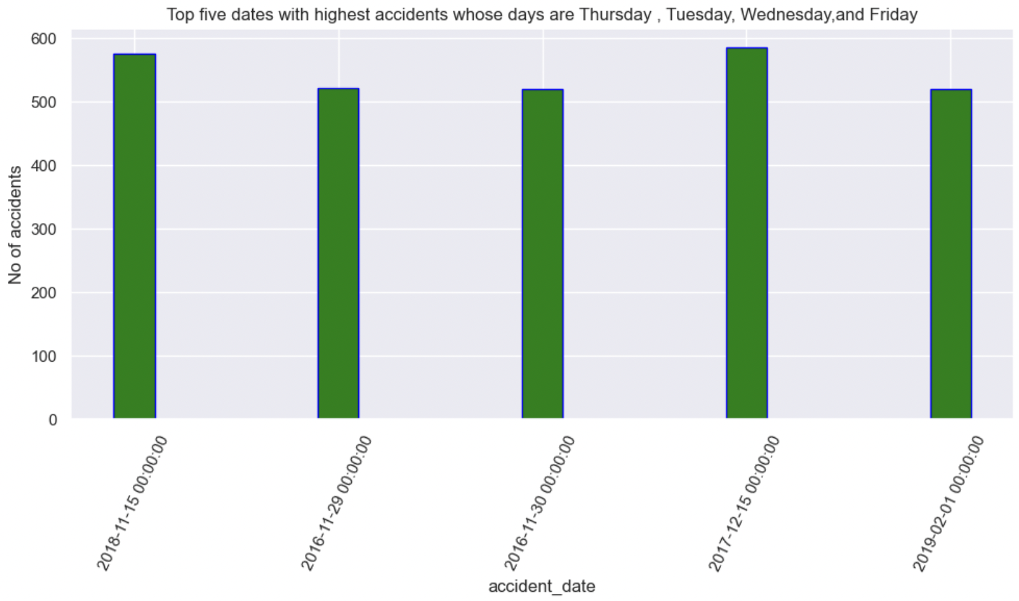
Analysis of top five days on which most accidents took place.
Thursday, Tuesday, Wednesday and Friday are the days in which most accidents took place based on dates of accidents.

Slide 22
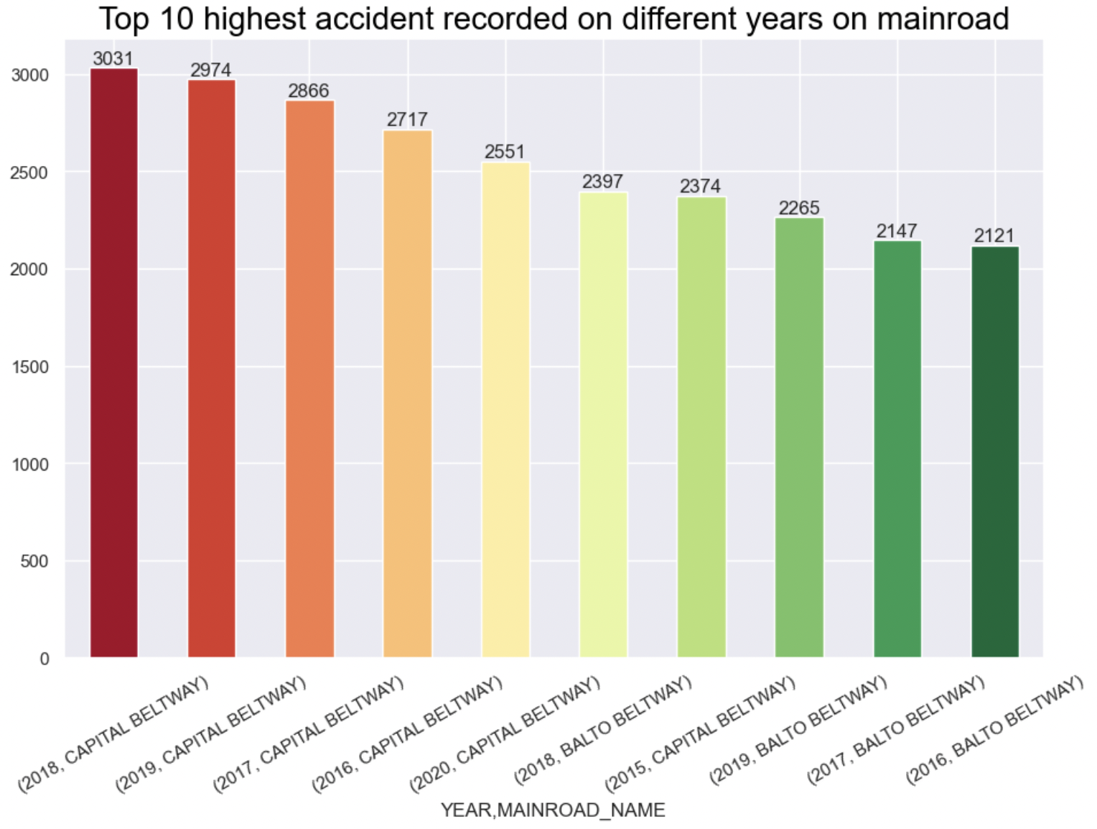
Analysis of top ten main roads on which most accidents took place and in what year.
Notes:
Capital beltway is the highest risk main road where mostly accidents are occurred almost every year

Slide 23
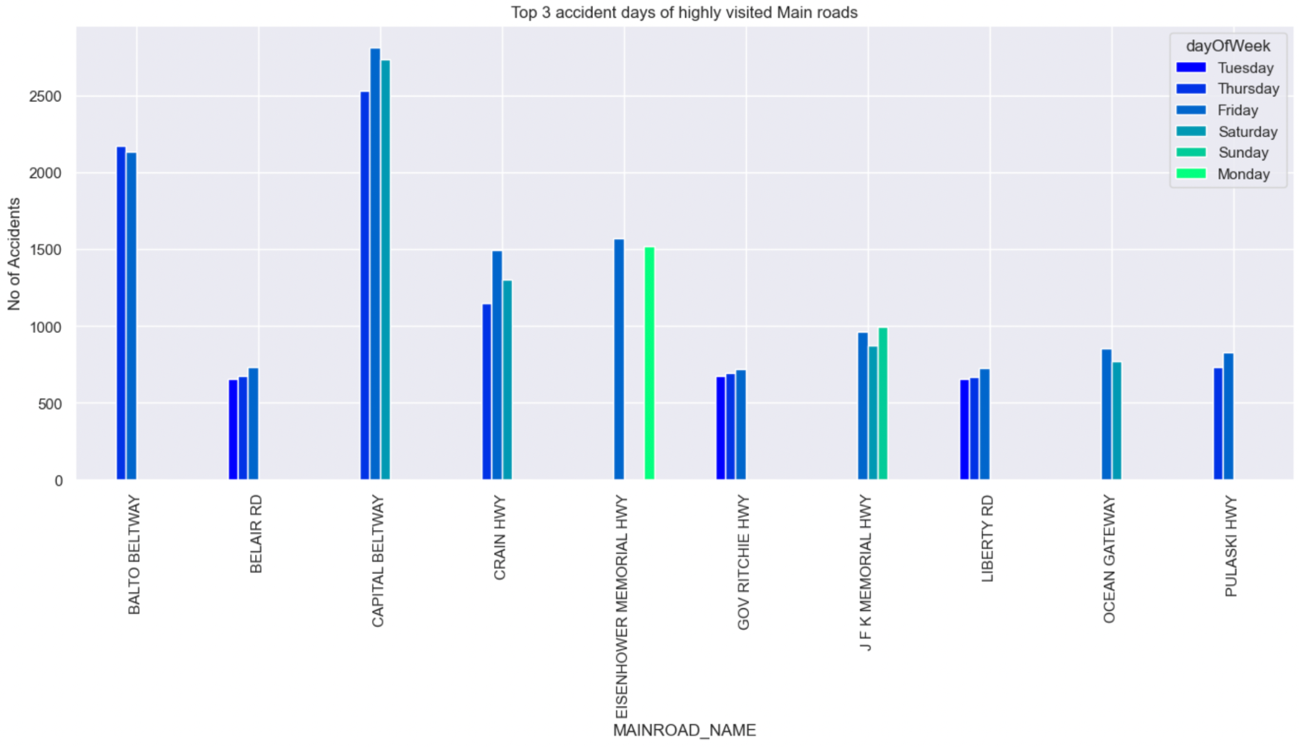
Analysis of days of the week in which most accidents took place on the main roads
Notes:
Capital Beltway highway has the highest number of accidents and those were recorded on Thursday,Friday and Saturday and likewise

Slide 24
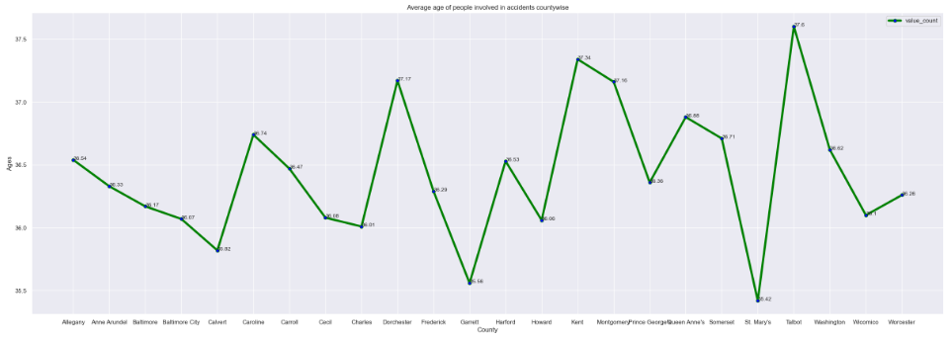
Analysis of average age of people involved in accidents for each county

Slide 25
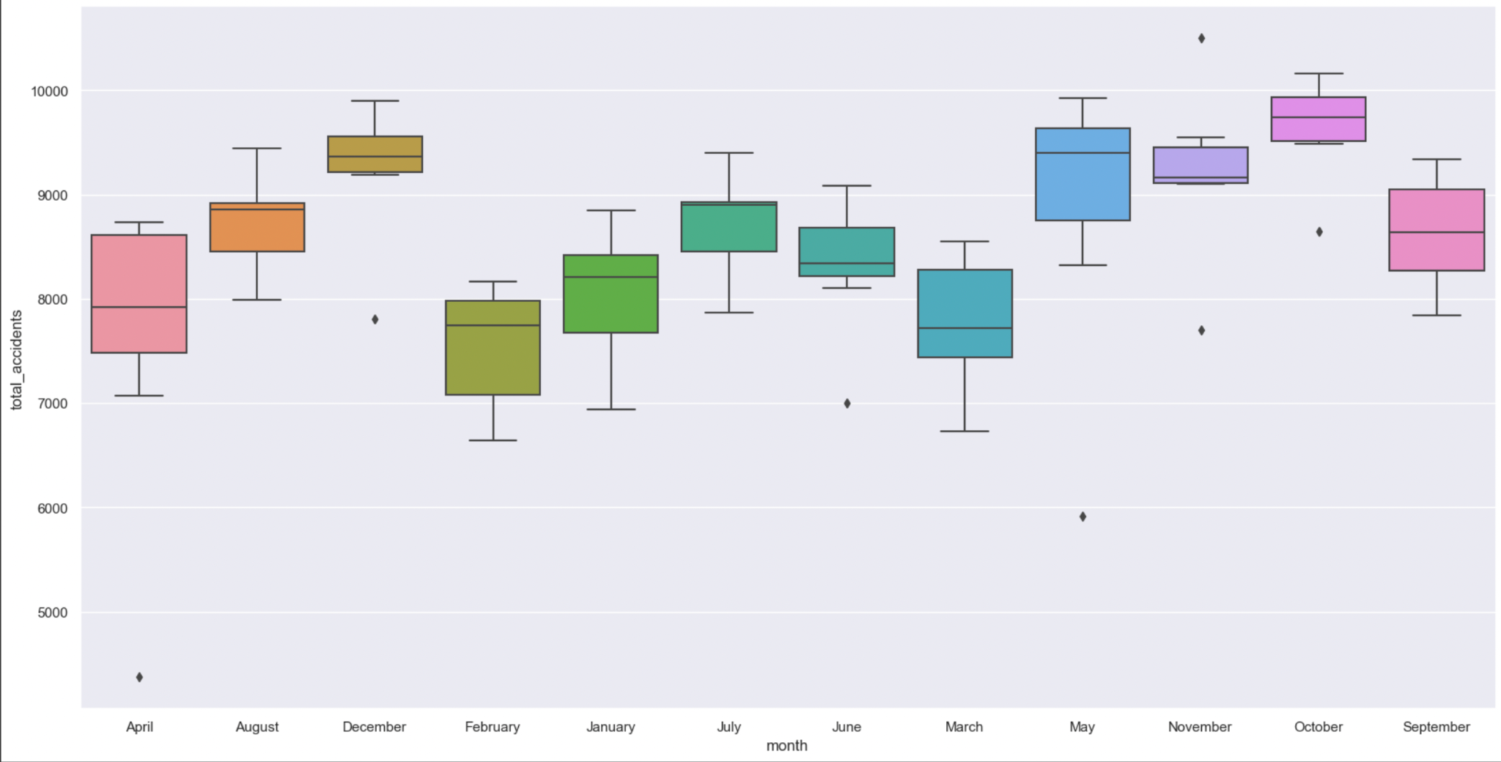
Ploting data by year and month to get average no of accidents per month.

Slide 26
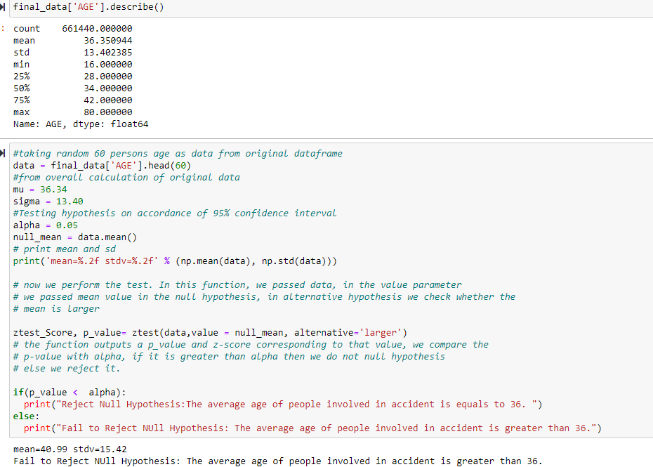
HYPOTHESIS TESTING : Ztest on age of crashes occurred

Slide 27

END

